Slide 1
LINE FOLLOWING ROBOT
BASED ON ARDUINO UNO

Slide 2
The parts required to build the robot
Arduino Uno (with cable)
L293D Motor Driver Shield for Arduino
Range adjustable IR sensor (x4)
Baseboard (x1)
Encoder disc (x2)
Deceleration DC Motors (x2)
Battery container (x1)
Wheels (x2)
Hammer castor (x1)
Jumper wires: male-to-male|male-to-female|female-to-female (x10)

Slide 3
Tools required:
Switch (x1)
Spacers (x4)
Fasteners (x4)
M3*30 screw (x4)
M3*8 screw (x20)
M3 nut (x18)
L12 spacer (x4)
Soldering Iron
Hot Glue Gun
Screw Driver
Gather these parts and be ready for the next step ...

Slide 4
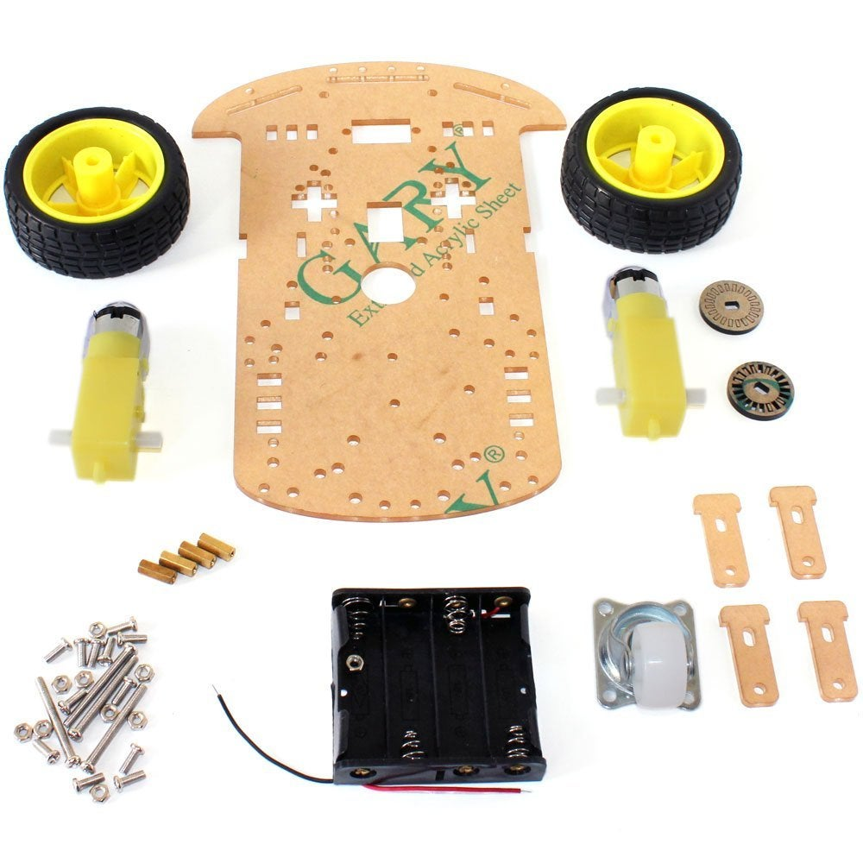
STEP : 1
We first connect the motors to the board by putting the fastener in the given slots and tightening them with M3*30 screws. Now, the wheels can be attached to the motors. Besides the two wheels, we are also provided with a hammer castor wheel which serves to support the motion of the robot by following the other two wheels while in motion. The castor wheel is attached along with the spacers provided, this maintains the height of the castor and keeps the robot in a fixed horizontal plane. Now that all the moving parts are taken care of, we come to the power supply which is provided with the help of 4 AA batteries. The battery container for the same is also provided with the DIY kit, it can be attached on the top. Note that the AA batteries are not necessarily the only power source to be used, we can use a 9V battery as well. If you have worked on with Arduino and motors, it will conspicuous in your that using either 4 AA batteries or one 9V battery won’t last long. What can better be done is using the 9V battery to supply power to Arduino and the AA batteries for the motor driver, or you can use some good current rating AA batteries only.

Slide 5
STEP : 2
So, by now, we have one easily assembled two-wheel drive robot. We now come to the electronics part. Take the Arduino and screw it to the baseboard (or you can use a double-sided tape as well). When done, attach the L293D Motor Driver Shield on the top of Arduino, making sure that corresponding pins in both are correctly connected. Take two wires each from both the motors and connect them to the motor driver shield placed on Arduino (say, M1 and M2). Check the connections for the same direction of motors as opposite polarity can cause counter motions. Now, we will shift our focus to the IR sensors which we place in the front. Two of them are used and both try to make bot move in such a way that the line it is traveling on is always in between the two. Connect the 5V and GND pins of the sensors to the 5V and GND points given in the shield. The input signal from the IR sensors is given through the Analog pins (here, we have used A0 and A1).
Through the serial monitor on Arduino IDE, we check the values of IR sensors when on the line and when not on the line. And, accordingly, we write a code with ‘if-else’ statements to make the bot move forward or turn left/right. The libraries for the motor driver shield can be downloaded online or directly go to this download URL: https://goo.gl/fScTIj . Include the libraries for the DC motors, define an object for each and also declare pins for the sensor. You can see the complete program below:

Slide 6
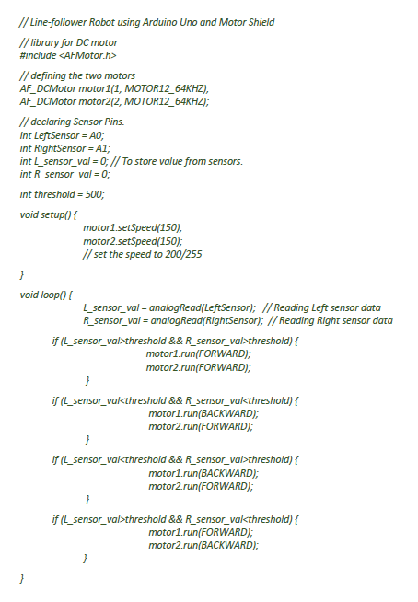
SOURCE CODE ///SKETCH

Slide 7
1 . U MANOJ 2. P KAMAL 3. SRICHARAN 4. Y KAMALESH 5. SHOAIB SHAIK
THANK YOU
Find out more at the PowerPoint Getting Started Center
(Click the arrow when in Slide Show mode)
Notes:
In Slide Show mode, click the arrow to enter the PowerPoint Getting Started Center.

